Slide 1
Digital Portfolio
STUDENT NAME: SAMUEL DANI J
REGISTER NO AND NMID: 2428C0510 &
809A772E50D9798A68A4824AA002AF5E
DEPARTMENT: B.Sc - AIML
COLLEGE: KPR COLLEGE/ BHARATHIYAR UNIVERSITY

Slide 2
PROJECT TITLE
AI/ML Developer Portfolio Website.

Slide 3


AGENDA
Problem Statement
Project Overview
End Users
Tools and Technologies
Portfolio design and Layout
Features and Functionality
Results and Screenshots
Conclusion
Github Link
3/21/2024 Annual Review

Slide 4

PROBLEM STATEMENT
To pursue a challenging and dynamic career as an AI/ML Developer, where I can utilize my expertise in artificial intelligence, machine learning, and data analytics to design innovative solutions that solve real-world problems. I aim to contribute to cutting-edge projects, enhance decision-making through data-driven insights, and continuously expand my knowledge in emerging AI technologies. My goal is to deliver meaningful impact by combining technical skills, creativity, and problem-solving abilities to develop intelligent systems that improve efficiency, accuracy, and innovation across industries.

Slide 5

PROJECT OVERVIEW
AI Crop Yield Prediction – Built a machine learning model to predict crop yields using soil, weather, and crop data for better agricultural decisions. Public Health Chatbot – Developed an AI chatbot using NLP to provide disease awareness and health guidance. Sales Forecasting System – Created predictive models to forecast sales trends and optimize inventory for retail businesses. Customer Sentiment Analysis – Analyzed customer feedback using NLP to generate actionable business insights.

Slide 6

WHO ARE THE END USERS?
Potential Employers / Recruiters – Companies looking to hire AI/ML developers for full-time or internship roles. Clients / Businesses – Individuals or organizations seeking freelance or consulting AI/ML solutions. Hackathon & Competition Judges – Evaluators in AI/ML contests who want to see your skills and projects. Collaborators / Team Members – Other developers, data scientists, or researchers interested in partnering on projects. Academic / Research Mentors – Professors or supervisors evaluating your work for research or academic purposes.

Slide 7

TOOLS AND TECHNIQUES
HTML CSS JavaScript Git and GitHub VS Code

Slide 8
PORTFOLIO DESIGN AND LAYOUT
Hero Section: Centered 3D interactive card with name, role, and “Hire Me” button; uses glassmorphism and gradient effects. About Me Section: Short bio highlighting background, skills, and AI/ML interests; visually clean with subtle shadow or blur. Skills Section: List of technical skills, frameworks, and tools; use icons, progress bars, or badges for visual appeal. Projects Section: 3–4 key projects displayed as cards with brief descriptions, tech stack, and outcomes; hover effects or flip animation for interactivity. Contact Section: Email, LinkedIn, GitHub links, and CTA buttons; minimalistic design with glowing or gradient accents matching the hero card.
8

Slide 9
FEATURES AND FUNCTIONALITY
Interactive 3D Card: The hero card tilts dynamically based on mouse movement, creating an engaging, futuristic effect. Project Showcase: Highlight key AI/ML projects with brief descriptions, tech stacks, and outcomes; cards can have hover or flip animations for interactivity. Skill Visualization: Display technical skills and tools using icons, badges, or progress bars for quick visual reference. Contact & Call-to-Action: Includes email link, “Hire Me” button, and social media links for easy professional engagement.

Slide 10
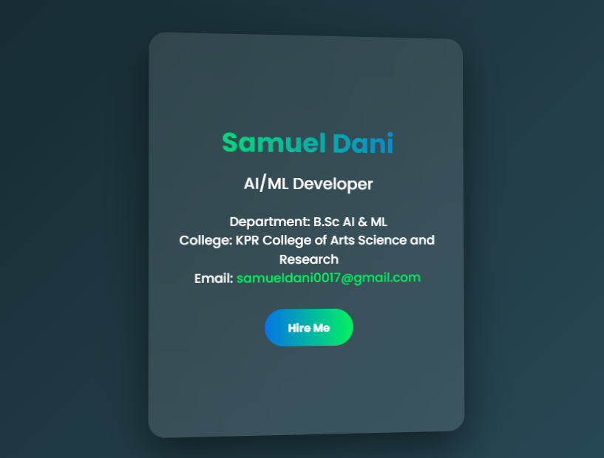

RESULTS AND SCREENSHOTS
3/21/2024 Annual Review
10

Slide 11
GITHUB LINK
https://github.com/samueldani09/sam-portfolio

Slide 12
CONCLUSION
Highlights my sports skills and career achievements Summarizes my journey, milestones, and dedication to the game Helps coaches, teams, and sponsors understand my potential Makes it easier for scouts, managers, and supporters to connect with me
12

